Slide 1

Semı-automatıc segmentatıon and annotatıon of vıdeos usıng alıgnment wıth audıo subtıtles
BERKE ESMER CEMAL AYTEKİN

Slide 2
Project outlıne
Speech Recognition
Use of body pose detection software
Clustering in time
GUI design for annotation

Slide 3
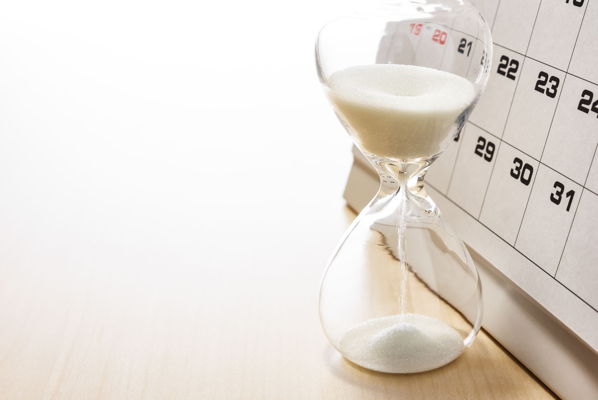
Week one

Slide 4
Agenda
Openpose framework
Demo examples, Key point JSON output
Python scripts – Frame Generator & Subtitle Parser
Google CoLab, Docker images
Manual dataset creation
Tensorflow, Keras
Github

Slide 5
Community based work
Google CoLab
Docker

Slide 6
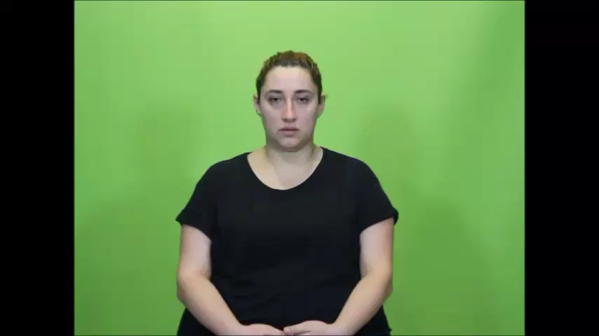

Slide 7
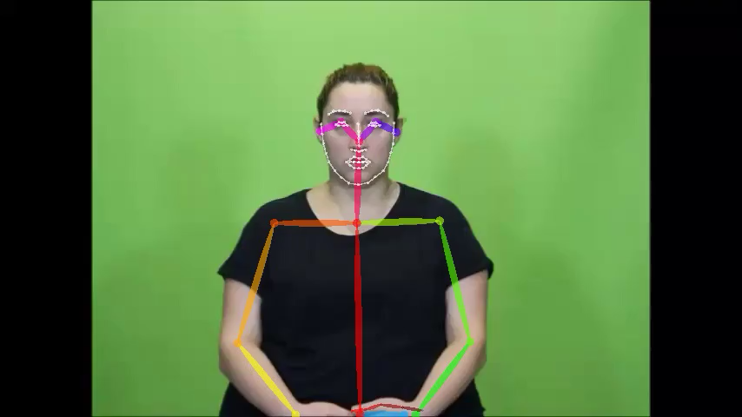

Slide 8
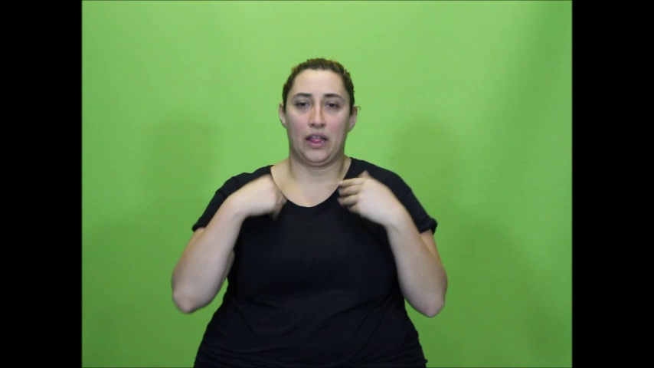
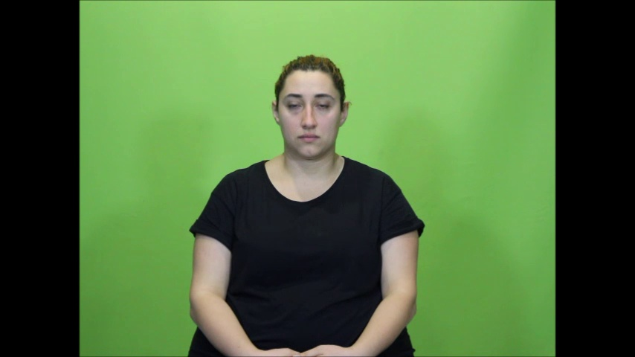

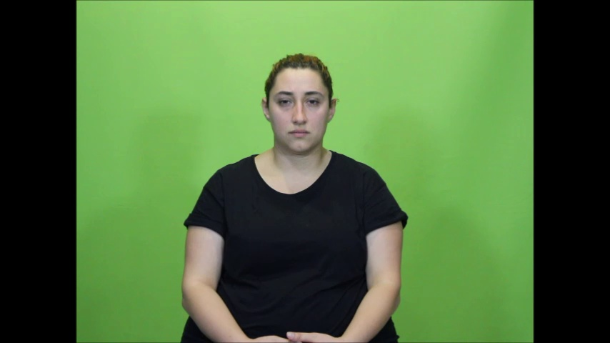
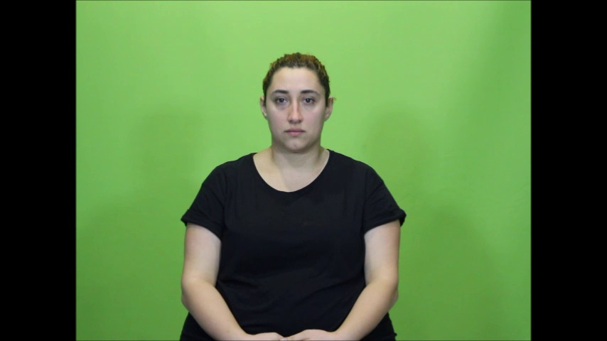
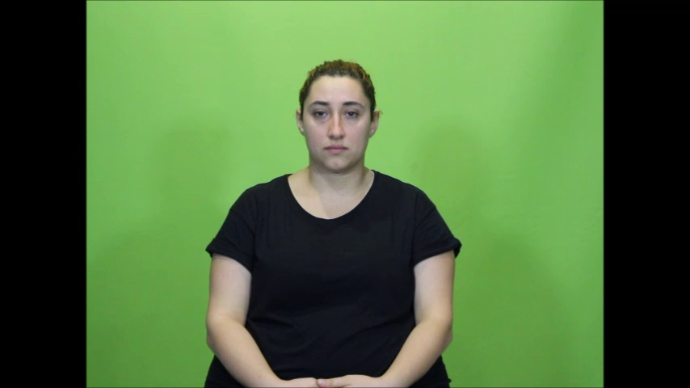
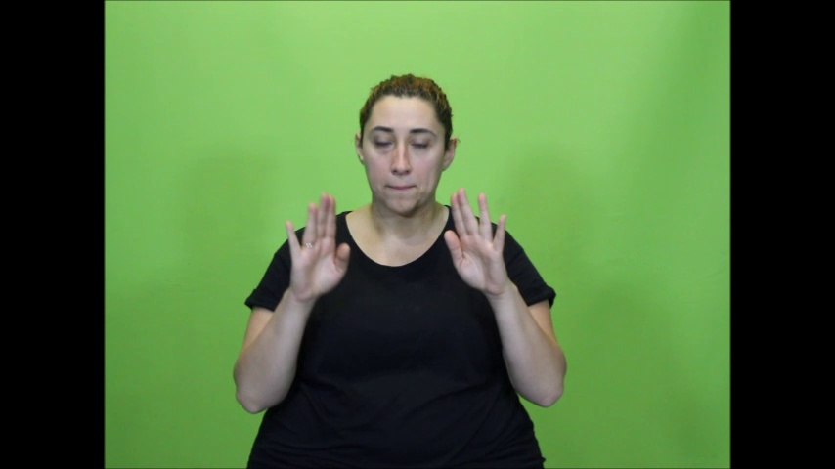
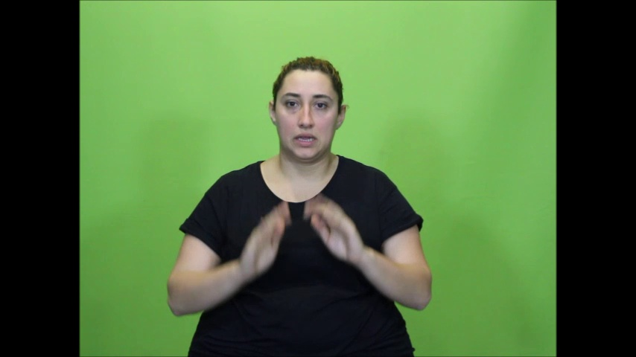

Slide 9
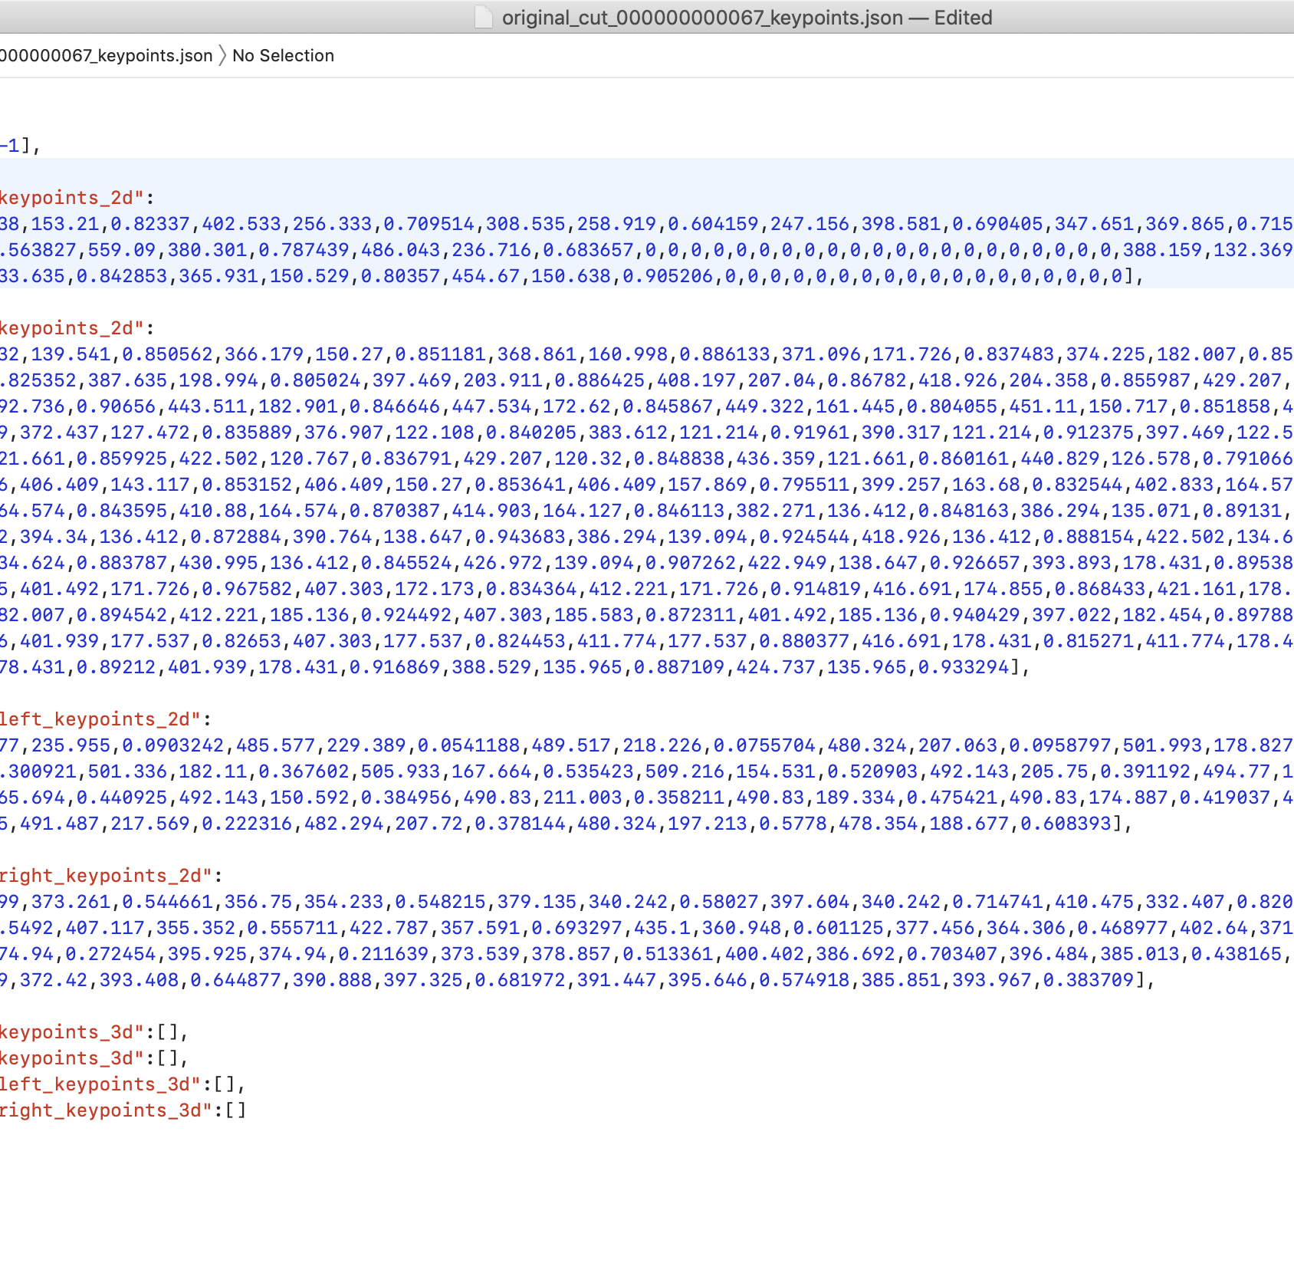
Notes:
Manual dataset, up and down libraries

Slide 10
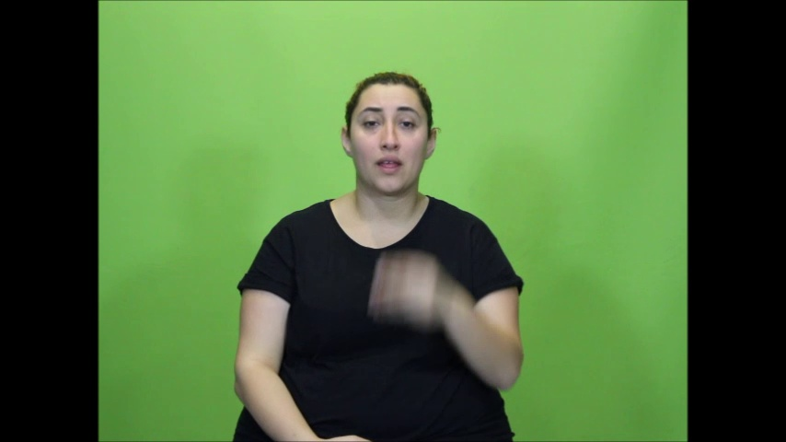
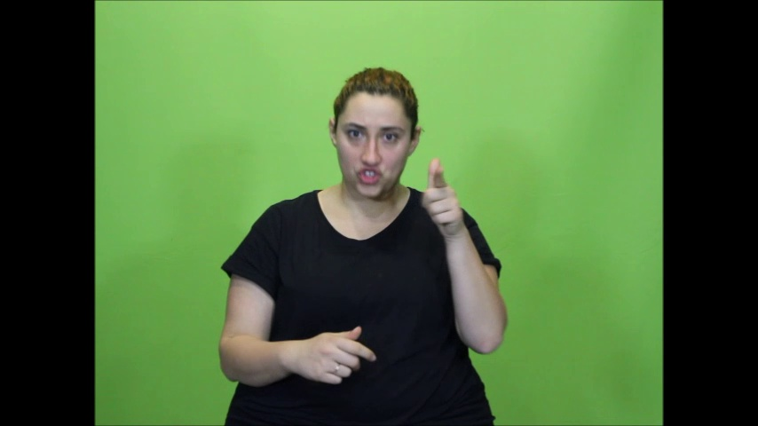
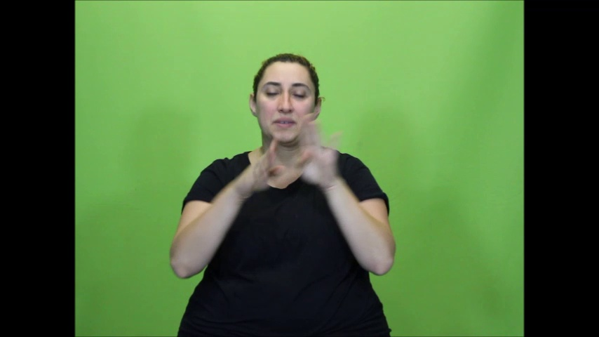

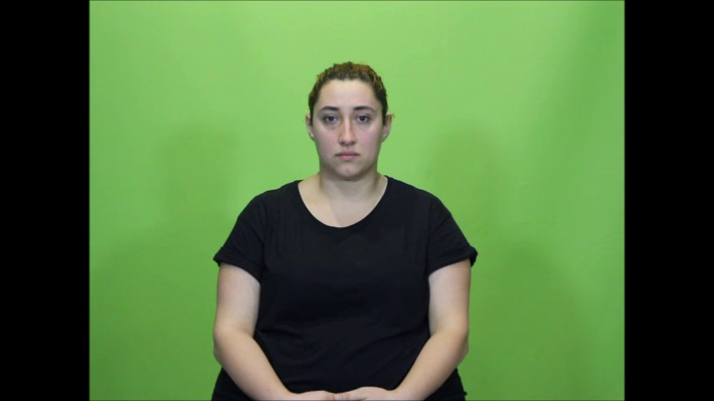


Slide 11
Week TWO

Slide 12
Agenda
More on openpose framework
Testing our model with a bigger dataset
Video segmentation by using frames
Key point JSON interpretation

Slide 13
TESTING MODEL
We worked on the full version of sign language video, 27:33 mins.
We generated all of the frames by a script we created last week.
Total of 40849 frames!

Slide 14
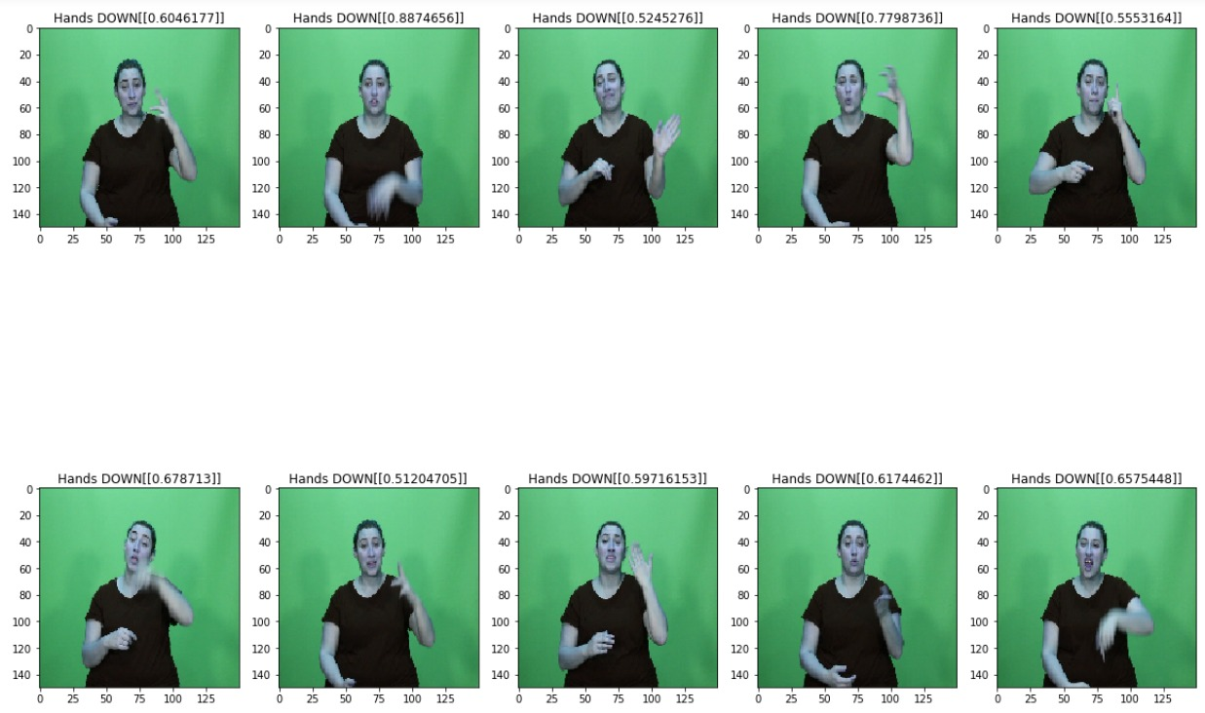

Slide 15
SEGMENTATION
In this task, we used the result of our previous test.
We took note of all up-frames and then determined the cut points.
Finally, we composed segmented videos by using those frames.

Slide 16
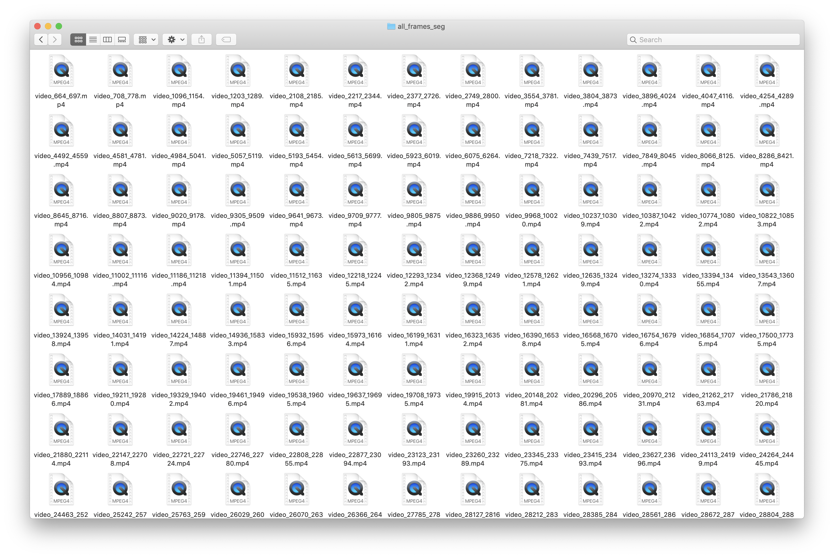
In total 158 videos

Slide 17
Play videos

Slide 18
JSON INTERPRETATION
We mapped the key points with their equivalents on pose body
We created a script that determines the angle in elbows.
Result could be used as another option to determine to find up/down frames.

Slide 19
{0, "Nose"}
{1, "Neck"}
{2, "RShoulder"}
{3, "RElbow"}
{4, "RWrist"}
{5, "LShoulder"}
{6, "LElbow"}
{7, "LWrist"}
{8, "MidHip"}
{9, "RHip"}
{10, "RKnee"}
{11, "RAnkle"}
{12, "LHip"}
{13, "Lknee"}
{14, "LAnkle"}
{15, "REye"}
{16, "LEye"}
{17, "REar"}
{18, "LEar"}
{19, "LBigToe"}
{20, "LSmallToe"}
{21, "LHeel"}
{22, "RBigToe"}
{23, "RSmallToe"}
{24, "RHeel"}
{25, "Background"}

Slide 20
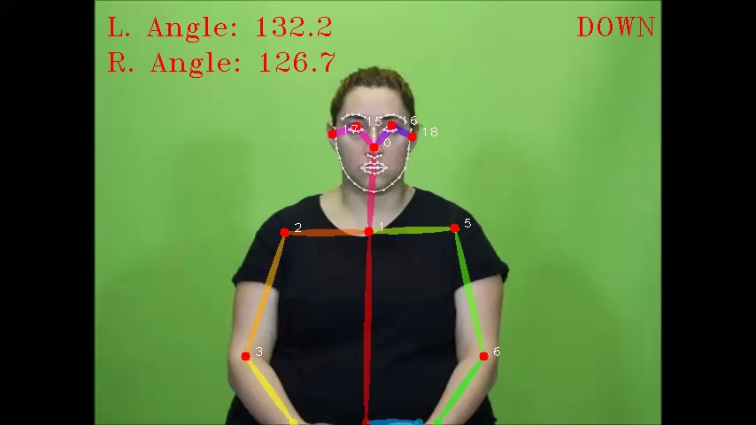
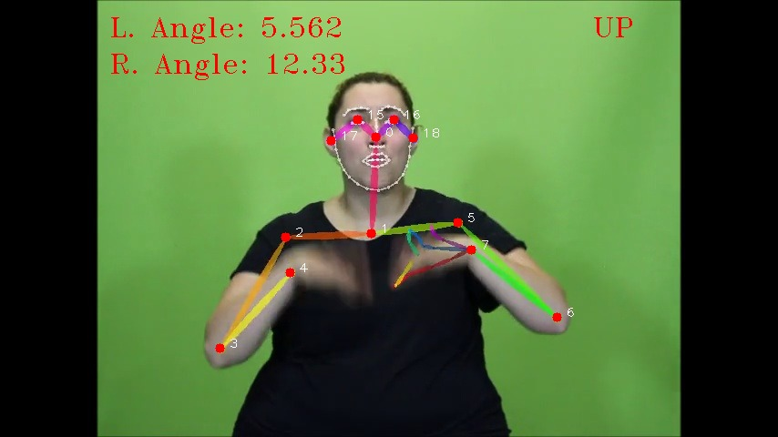

Slide 21
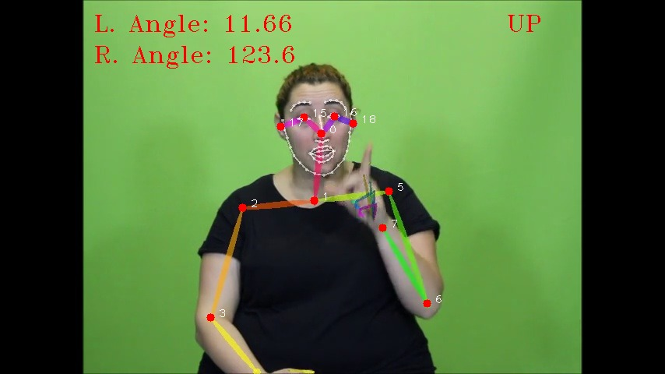
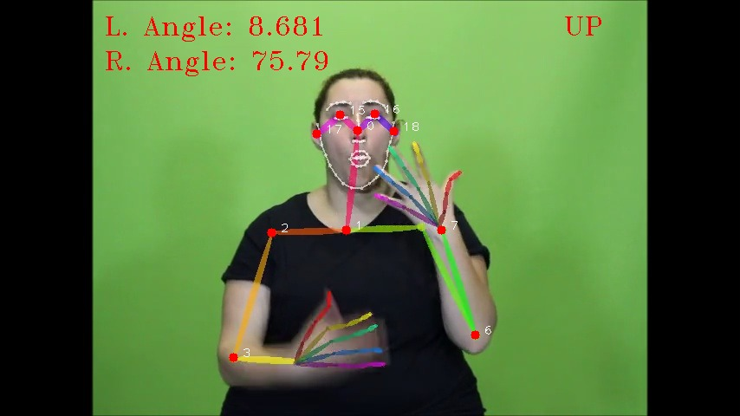

Slide 22
Week THREE

Slide 23
Agenda
Alignment problem
An heuristic solution
Turkish Sign Language
Global alignment

Slide 24
An Heurıstıc Solutıon
We had 156 segmented videos from previous week.
We parsed the subtitles using time difference between back-to-back texts.
Using the threshold t = 0.750s, we extracted 156 subtitle blocks.
Considering the length of 5:27, only 2 block is inconsistent.

Slide 25
156 Blocks
Notes:
5193_5454 = İlk blok

Slide 26
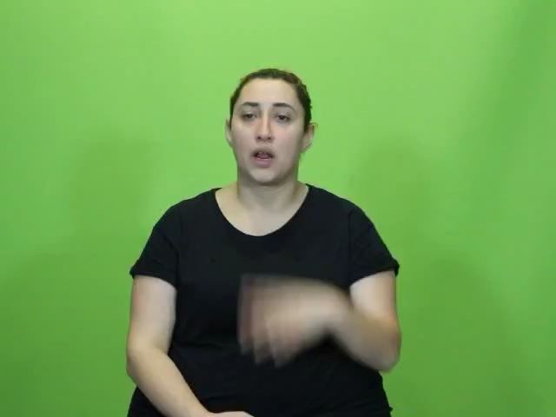
The block corresponds to this frame

Slide 27
Global Alıgnment

Slide 28
🤟
The gesture for “I love you” in American Sign Language, shown as a raised pinky (little) finger, index finger, and an extended thumb.
Love-You Gesture was approved as part of Unicode 10.0 in 2017 under the name “I Love You Hand Sign” and added to Emoji 5.0 in 2017.
Reference: emojipedia.org

